Slide 1
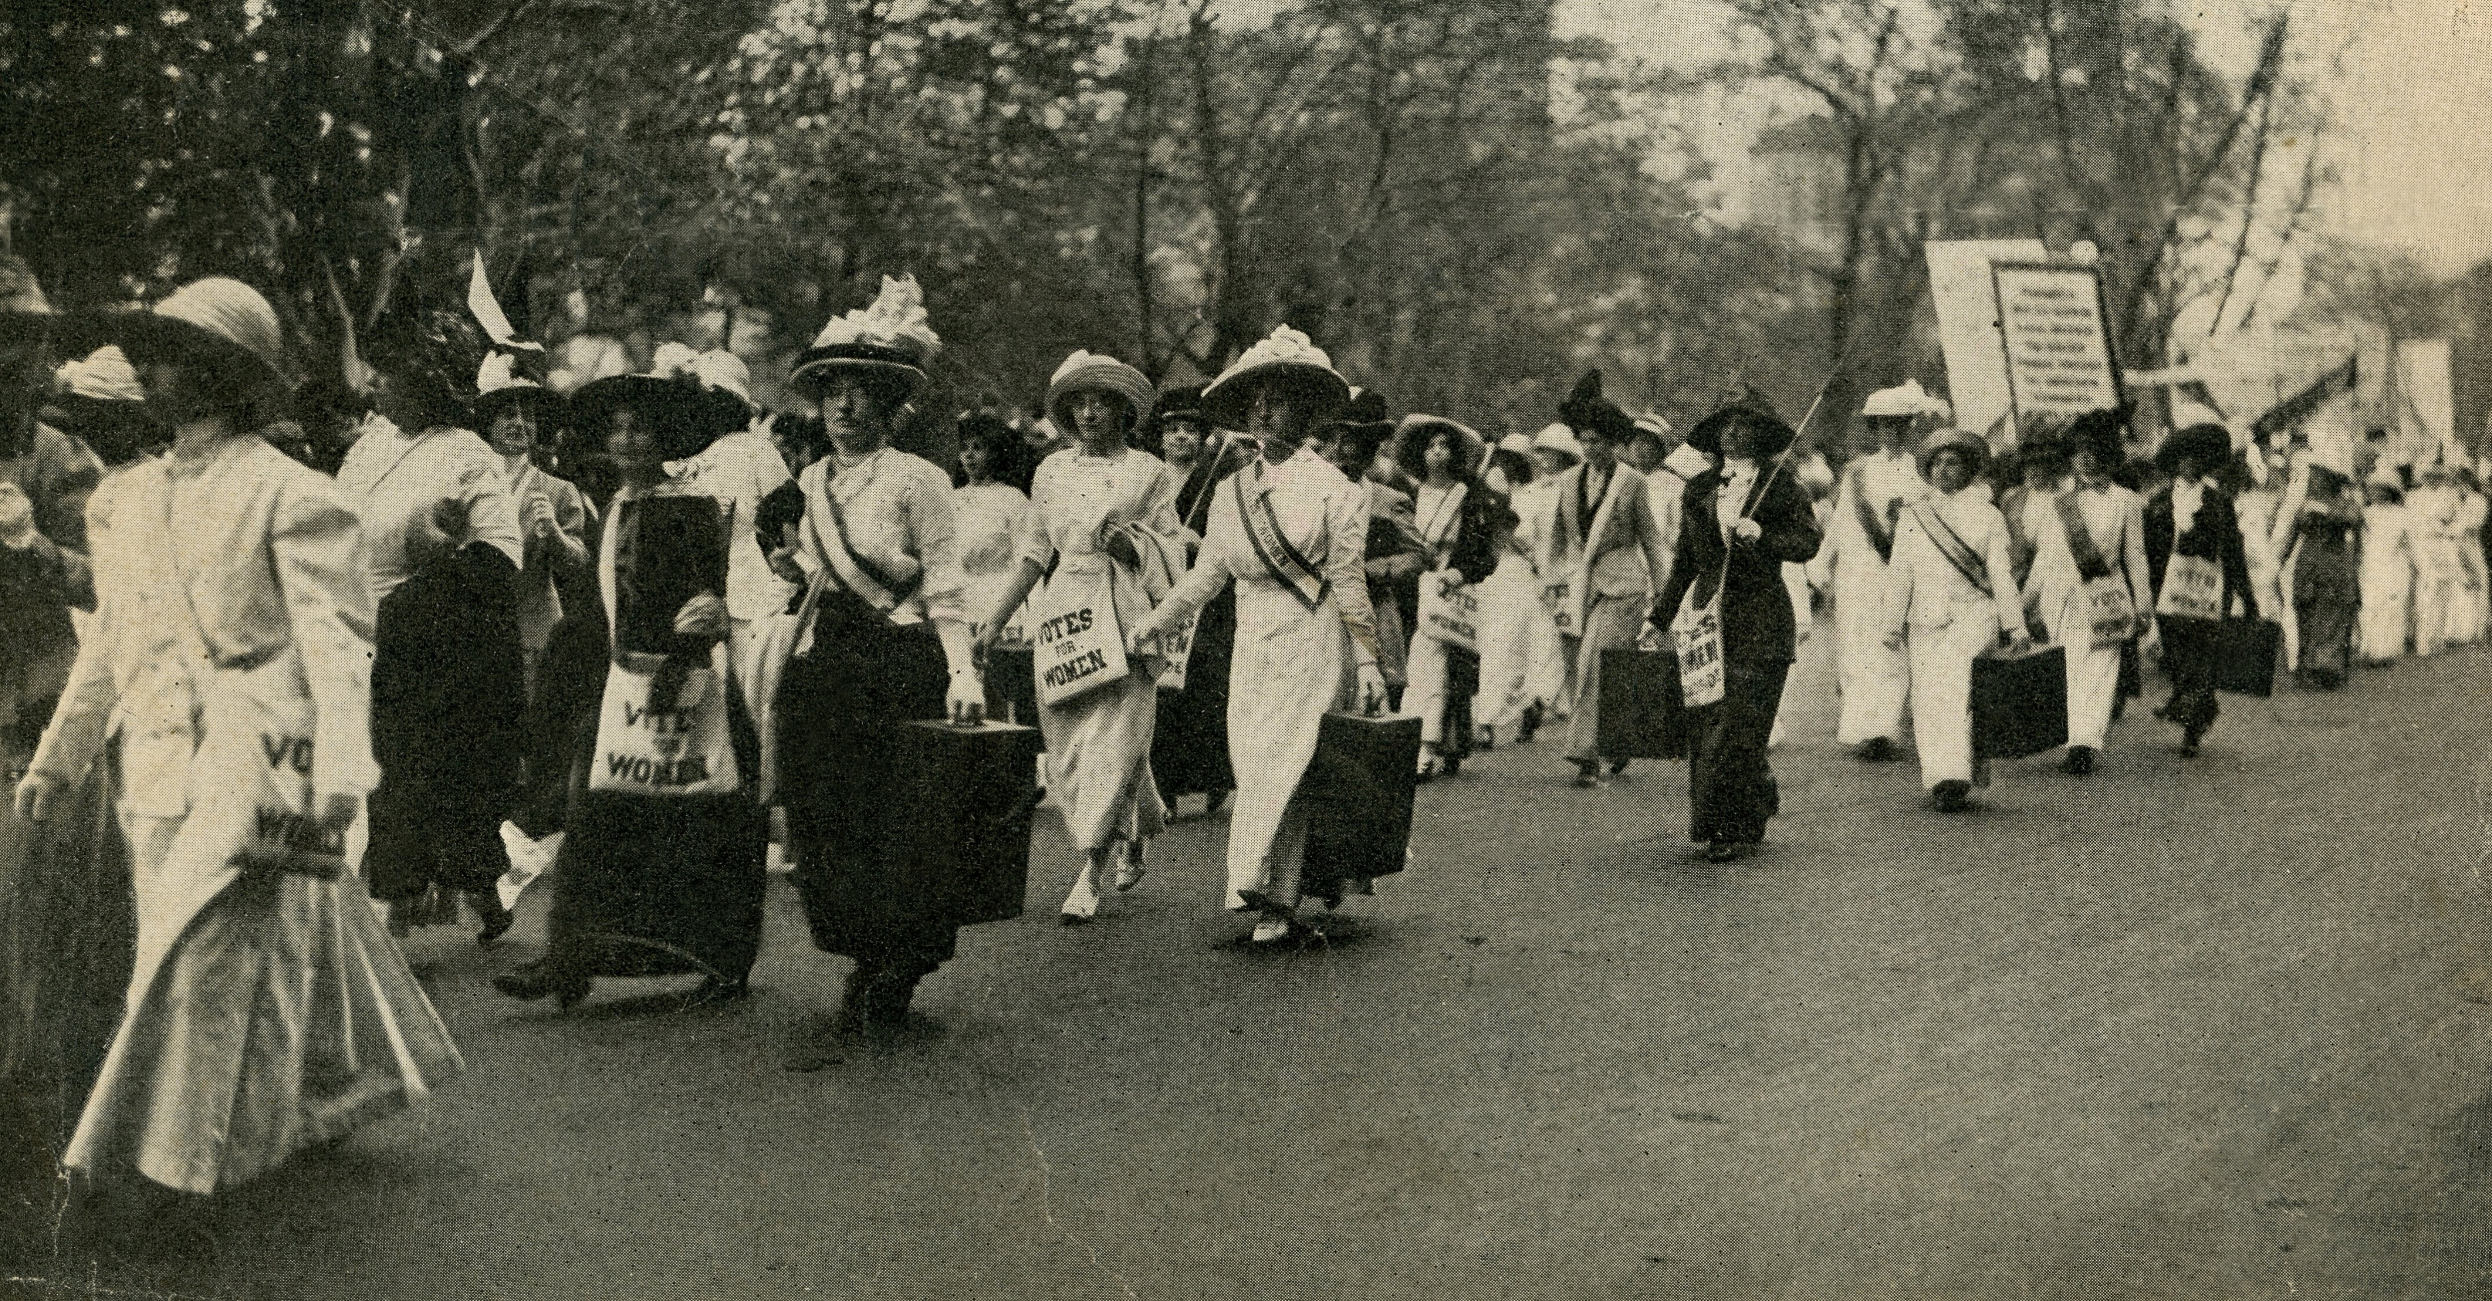
Your voice matters!
Inform your vote.
Don’t let someone else decide who represents you.
Use Vote411.org a non-partisan online voter guide from the League of Women Voters®
Vote in Washington State’s Primary Election
Ballots mailed by July 19 | Must be returned by August 6
Washington State Primary Election
Ballots mailed by July 19 | Must be returned by August 6
Use Vote411.org a non-partisan online voter guide from the League of Women Voters®

Slide 2
Your voice matters!
Inform your vote.
Don’t let someone else decide who represents you.
Use Vote411.org a non-partisan online voter guide from the League of Women Voters®
Vote in Washington State’s Primary Election
Ballots mailed by July 19 Return by August 6
Vote in the Washington State Primary Election
Ballots mailed by July 19 Return by August 6
Use Vote411.org a non-partisan online voter guide from the League of Women Voters®

Slide 3
Postcard Front/Back: General
Front
Back
Don’t let someone else decide who represents you.
Important Election Dates
July 8 – Deadline for online voter registration and address change
July 19 – Ballots mailed to voters; ballot delivery date will differ based on county and local mail service
July 29 – Deadline for in-person new WA State voter registration
August 6 – Primary – Drop in a local drop box by 8pm or mail with free postage – must be in the mail by the last USPS pick-up and postmarked on the 6th (check your local USPS)
Don’t forget to mail in your ballot or use a local drop box by August 6 – postage is free!
Visit www.sos.wa.gov/elections for more information about Washington State Elections
Visit www.lwvwa.org for more information about The League in Washington State
Inform your vote! Use VOTE411.org from the League of Women Voters, a non-partisan online voter guide

Slide 4
Primary and General Election reminder handouts
Front
Back
Important Election Dates
July 8 – Deadline for online voter registration and address change
July 19 – Ballots mailed to voters; ballot delivery date will differ based on county and local mail service
July 29 – Deadline for in-person new WA State voter registration
August 6 – Primary – Drop in a local drop box by 8pm or mail with free postage – must be in the mail by the last USPS pick-up and postmarked on the 6th (check your local USPS)
Don’t let someone else decide who represents you.
Your vote matters!
Don’t forget to mail in your ballot or use a local drop box – Postage is Free!
Primary Election | Ballots mailed by July 19 | Return by August 6
Visit www.sos.wa.gov/elections for more information about Washington State Elections
Visit www.lwvwa.org for more information about The League in Washington State
Inform your vote! Use VOTE411.org from the League of Women Voters, a non-partisan online voter guide

