Slide 1
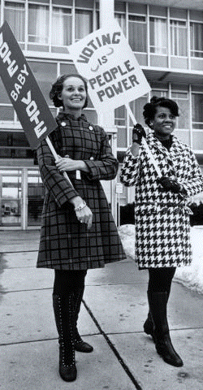
YOUR VOICE MATTERS!
USE VOTE411.ORG A NON-PARTISAN ONLINE VOTER GUIDE FROM THE LEAGUE OF WOMEN VOTERS®
WA STATE GENERAL ELECTION
Ballots mailed Oct 18
Return by Nov 6
DON’T LET SOMEONE ELSE DECIDE WHO REPRESENTS YOU
VOTE IN WA STATE’S GENERAL ELECTION
BALLOTS MAILED OCT 18 | RETURN BY NOV 5
USE VOTE411.ORG A NON-PARTISAN ONLINE VOTER GUIDE FROM THE LEAGUE OF WOMEN VOTERS®

Slide 2
YOUR VOICE MATTERS!
USE VOTE411.ORG A NON-PARTISAN ONLINE VOTER GUIDE FROM THE LEAGUE OF WOMEN VOTERS®
WA STATE GENERAL ELECTION
Ballots mailed Oct 18
Return by Nov 6
DON’T LET SOMEONE ELSE DECIDE WHO REPRESENTS YOU
VOTE IN WA STATE’S GENERAL ELECTION
BALLOTS MAILED OCT 18 | RETURN BY NOV 5
USE VOTE411.ORG A NON-PARTISAN ONLINE VOTER GUIDE FROM THE LEAGUE OF WOMEN VOTERS®

Slide 3
Postcard Front/Back: General
Front
Back
DON’T LET SOMEONE ELSE DECIDE WHO REPRESENTS YOU
IMPORTANT ELECTION DATES
OCT 8 – Ballots mailed to voters; ballot delivery date will differ based on county and local mail service
OCT 28 – Deadline for online voter registration and address change
NOV 5 – Same-day registration available! Deadline for in-person WA State voter registration or updates
NOVEMBER 5 – GENERAL ELECTION – Drop in a local drop box by 8pm or mail with free postage – must be in the mail by the last USPS pick-up and postmarked on the 5th (check your local USPS)
YOUR VOTE MATTERS!
DON’T FORGET TO MAIL IN YOUR BALLOT OR USE A LOCAL DROP BOX BY NOVEMBER 5 – POSTAGE IS FREE!
Inform your vote! Use VOTE411.org from the
League of Women Voters, a non-partisan online voter guide
Visit www.sos.wa.gov/elections for more information about Washington State Elections
Visit www.lwvwa.org for more information about The League in Washington State

Slide 4
Handout Front/Back: General
Front
Back
DON’T LET SOMEONE ELSE DECIDE WHO REPRESENTS YOU
IMPORTANT ELECTION DATES
OCT 8 – Ballots mailed to voters; ballot delivery date will differ based on county and local mail service
OCT 28 – Deadline for online voter registration and address change
NOV 5 – Same-day registration available! Deadline for in-person WA State voter registration or updates
NOVEMBER 5 – GENERAL ELECTION – Drop in a local drop box by 8pm or mail with free postage – must be in the mail by the last USPS pick-up and postmarked on the 5th (check your local USPS)
YOUR VOTE MATTERS!
DON’T FORGET TO MAIL IN YOUR BALLOT OR USE A LOCAL DROP BOX BY NOVEMBER 5 – POSTAGE IS FREE!
Inform your vote! Use VOTE411.org from the
League of Women Voters, a non-partisan online voter guide
Visit www.sos.wa.gov/elections for more information about Washington State Elections
Visit www.lwvwa.org for more information about The League in Washington State

