Slide 1
Vote411.org
Your portal to your ballot, state voting requirements, a link to registering, much else.

Slide 2
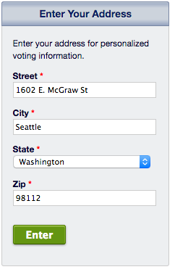
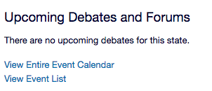
When you enter Vote411.org you have lots of choices. You can
…which takes you to here. Click on the green bar and go to what’s on your ballot,
or see if there’s a debate or forum coming up in your area.
Start here

Slide 3
Or you can
Link to online registration form
Link to voting information for any state

Slide 4
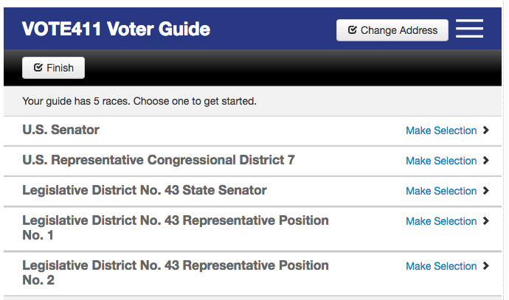
If you clicked on the long green bar, you’ll come to a page that looks like this, and then you can choose which you want to know more about by clicking on that race.

Slide 5
The results will look something like this, beginning with a description of the office, then information about the candidates in that race.
One of the various League questions, and candidate responses, might look somewhat like this

Slide 6
If one of the candidates has not responded to the League’s invitation, the page will show
Candidate has not yet responded.
If you see that, consider contacting that candidate and asking them to respond. Let them know you want to know more about them before you make your ballot decisions.

