Slide 1
Plenary Session IV
#LWVWA2019
★ Call Back to Order
Ann Murphy, LWVWA President

Slide 2
Plenary Session IV
#LWVWA2019
Credentials Report and
Statement of Quorum
By Nancy Dahl
★ Convention Business 

Slide 3
Plenary Session IV
#LWVWA2019
LWVWA Strategic Plan Review by LWVWA President Ann Murphy
★ Convention Business 

Slide 4
Plenary Session IV
#LWVWA2019
Goals & Strategies-2017
Increase League Impact
Facilitate Local League Work
Strengthen Organizational Capacity
★ Convention Business 

Slide 5
Plenary Session IV
#LWVWA2019
Goals & Strategies #1: Increase League Impact
• Develop a robust external League communication plan
• Increase civic and issue education
• Enhance voter services
• Enhance advocacy outcomes affecting public policy
• Motivate attitudes toward the value of civic involvement
• Build stronger relationships with League allies and partners

Slide 6
Plenary Session IV
#LWVWA2019
Goals & Strategies #2: Facilitate Local League Work
• Help local Leagues increase membership and new leadership
• Increase diversity of ethnicity, age, gender and socio-economic status at all levels of League
• Support on-going training and exchange of ideas
• Support local League fund development

Slide 7
Plenary Session IV
#LWVWA2019
Goals & Strategies #3: Strengthen Organizational Capacity
• Consider reorganization of the LWVWA non-profit structure
• Hire additional staff
• Develop necessary funding to achieve League goals
• Invest in technical support needed to support state and local Leagues
• Develop and implement short- and long-term communication plans
• Establish policies and procedures needed to assure organizational effectiveness and continuity

Slide 8
LWVUS Transformation Roadmap – June 2018
Plenary Session IV
FOCUS
HEALTH OF NETWORK
CAPACITY
CULTURE

Slide 9
Plenary Session IV
Strategic Focus
Culture
Culture
Healthy Network
Capacity/
Resources

Slide 10
Plenary Session IV
Making Democracy Work®
Strategic Focus | C4 | C3
Impact | Advocacy | Voter Service
 | Marketing PR | Civics Ed in Schools—TSWI Census/Redistricting— Forum in a Box
 | Advocacy | Citizen Education
 | New positions | Potential new studies
Facilitate Local Leagues | Convention | Council (Trainings)
 | Communication | MELD (5 Groups)
 | Local League Presidents | $ Grants
Capacity / Structure | Budget | Budget
 | Policies-Bylaws
 | Office Staff
 | Communication
Diversity, Equity, and Inclusion—Action Plan

Slide 11
Plenary Session IV
Making Democracy Work®
Strategic Focus | C4 | C3
Impact | Advocacy | Voter Service
 | Marketing PR | Civics Ed in Schools—TSWI Census/Redistricting— Forum in a Box
 | Advocacy | Citizen Education
 | New positions | Potential new studies
Facilitate Local Leagues | Convention | Council (Trainings)
 | Communication | MELD (5 Groups)
 | Local League Presidents | $ Grants
Capacity / Structure | Budget | Budget
 | Policies-Bylaws
 | Office Staff
 | Communication
Diversity, Equity, and Inclusion—Action Plan

Slide 12
Plenary Session IV
Making Democracy Work®
Strategic Focus | C4 | C3
Impact | Advocacy | Voter Service
 | Marketing PR | Civics Ed in Schools—TSWI Census/Redistricting— Forum in a Box
 | Advocacy | Citizen Education
 | New positions | Potential new studies
Facilitate Local Leagues | Convention | Council (Trainings)
 | Communication | MELD (5 Groups)
 | Local League Presidents | $ Grants
Capacity / Structure | Budget | Budget
 | Policies-Bylaws
 | Office Staff
 | Communication
Diversity, Equity, and Inclusion—Action Plan

Slide 13
Plenary Session IV
Making Democracy Work®
Strategic Focus | C4 | C3
Impact | Advocacy | Voter Service
 | Marketing PR | Civics Ed in Schools—TSWI Census/Redistricting— Forum in a Box
 | Advocacy | Citizen Education
 | New positions | Potential new studies
Facilitate Local Leagues | Convention | Council (Trainings)
 | Communication | MELD (5 Groups)
 | Local League Presidents | $ Grants
Capacity / Structure | Budget | Budget
 | Policies-Bylaws
 | Office Staff
 | Communication
Diversity, Equity, and Inclusion—Action Plan

Slide 14
Plenary Session IV
#LWVWA2019
Making Democracy Work®
Strategic Focus | C4 | C3
Impact | Advocacy | Voter Service
 | Marketing PR | Civics Ed in Schools—TSWI Census/Redistricting— Forum in a Box
 | Advocacy | Citizen Education
 | New positions | Potential new studies
Facilitate Local Leagues | Convention | Council (Trainings)
 | Communication | MELD (5 Groups)
 | Local League Presidents | $ Grants
Capacity / Structure | Budget | Budget
 | Policies-Bylaws
 | Office Staff
 | Communication
Diversity, Equity, and Inclusion—Action Plan
Diversity,
Equity,
Inclusion

Slide 15
Plenary Session IV
#LWVWA2019
Adoption of Program
★ Convention Business 

Slide 16
Plenary Session IV
#LWVWA2019
Motion #19-03:
I move to Re-Adopt the Current LWVWA positions in the areas of Government, Transportation, Natural Resources and Social Policy as written in 2017-2019 Program in Action. The LWVWA Board recommends continued efforts in the campaign for Making Democracy Work®.
★ Convention Business 

Slide 17
Plenary Session IV
#LWVWA2019
Motion #19-04B:
I move to adopt the Recommended Program
of Work Item #2—Update on Protecting Washington State’s Shorelines as outlined on page 23
of the workbook.
★ Convention Business 

Slide 18
Plenary Session II
#LWVWA2019
Motion #19-04:
I move to adopt the Recommended Program of Work Item #3—concurrence with the LWV Kitsap County proposal to update language in the current Gun Control position to reflect current usage of Gun Safety as outlined on page 23 of the workbook.
★ Convention Business 

Slide 19
Plenary Session IV
#LWVWA2019
Vote on Not-Recommended
Program
★ Convention Business 

Slide 20
Plenary Session II
#LWVWA2019
Motion #19-06a:
I move to adopt the Not-Recommended item titled "Development of toolkits on a range of election methods, to support citizen education" as listed on page 24 of the convention workbook.
★ Convention Business 

Slide 21
Plenary Session II
#LWVWA2019
Motion #19-06b:
I move Concurrence with the LWV Snohomish County position on Civil Discourse as listed on page 24 of the Convention Workbook. This position states: “promote civil discourse through action and education of all government bodies, staff and the public for the purpose of improved public policy decisions and processes. Civil discourse means, at a minimum, mutual, respectful, courteous, constructive, and orderly communication.” This would be a new policy RG-4 in 2017-19 LWVWA Program in Action, page 17, Regional Government Structures (1981).
★ Convention Business 

Slide 22
Plenary Session IV
#LWVWA2019
NEW: Motion #19-XX:
I move to amend Motion #19-09 to read: "to adopt the LWVWA 2019-2021 per Member payment as follows - $19 for 2019-2021.", striking the remainder that reads "and $20 for 2020-2021."
— Melissa Taylor
★ Convention Business 

Slide 23
Plenary Session IV
#LWVWA2019
NEW: Motion #19-XX:
I move that we transfer the $2134 originally planned from increased PMP in the Dues from PMP section to the Contributions/Development section.
— Melissa Taylor
★ Convention Business 

Slide 24
Plenary Session IV
#LWVWA2019
Motion to Adopt Recommended Bylaw Amendments
Motion #19-07: I move to Adopt the Recommended Bylaw Amendments for LWVWA as presented on page 31 of the Convention Workbook. —Lunell Haught, LWVWA Board
★ Convention Business 

Slide 25
Plenary Session IV
#LWVWA2019
Motion to Adopt Recommended Bylaw Amendments
Motion #19-07: I move to Adopt the Recommended Bylaw Amendments for LWVWA as presented on page 31 of the Convention Workbook. —Lunell Haught, LWVWA Board
★ Convention Business 

Slide 26
Plenary Session IV
#LWVWA2019
Motion to Adopt the 2019-21 Per Member Payment Motion #19-09 I move to adopt the LWVWA 2019-21 per Member payment as follows: $19 for 2019-20; and $20 for 2020-21.
—Joanna Cullen, LWVWA Treasurer
★ Convention Business 

Slide 27
Plenary Session IV
#LWVWA2019
Motion to Adopt the LWVWA 2019-21 Budget Motion #19-08 I move to adopt the LWVWA 2019-21 LWVWA Budget as presented on page 32-34 of the Convention Workbook and amended.
—Myra Howrey, Budget Committee Chair
★ Convention Business 

Slide 28
Plenary Session IV
#LWVWA2019
NEW: Motion #19-20:
I move that we adopt the following resolution:
Be it resolved that the LWVWA and local leagues advocate for fair and equal protection for property owners, and the LWVWA will ask each local league to respond to a questionnaire about the Board of Equalization for that county.
— Becky Flarity
★ Convention Business 

Slide 29
Plenary Session IV
#LWVWA2019
NEW: Motion #19-21:
I move that the Convention adopt the following resolution:
Be it resolved that we as the LWVWA and associated local Leagues shall address climate change when opportunities are available. We shall be cognizant of our carbon footprint, and when practical incorporate plans to minimize it in conducting events such as meetings and forums. Also, we shall consider the effect of the latest forecasts on climate change when analyzing issues and planning actions.
— Martin Gibbins
★ Convention Business 

Slide 30
Plenary Session IV
#LWVWA2019
Motion to Adopt Resolutions Motion #19-XX: Be it resolved that we as the LWVWA and associated local Leagues shall address climate change when opportunities are available. We shall be cognizant of our carbon footprint and when practical incorporate plans to minimize it in conducting events such as meetings and forums. Also, we shall consider the effect of the latest forecasts on climate change when analyzing issues and planning actions.
—Resolutions Committee
★ Convention Business 

Slide 31
Plenary Session IV
#LWVWA2019
Motion to Adopt Resolutions Motion #19-XX: Be it resolved that the LWVWA and local leagues advocate for fair and equal protection for property owners, and the LWVWA will ask each county league to respond to a questionnaire about the Board of Equalization for that county.
★ Convention Business 

Slide 32
Plenary Session IV
#LWVWA2019
Congratulations!
Community Connections Award LWV Bellingham-Whatcom for Every Vote Counts Project
Strengthening Democracy Award LWV Clallam County for Kids Voting Project
Effective Member Engagement and Recruitment Award LWV Thurston County for Coffee with the League Project
Dorothy Roberts Award Kathy Sakahara
Good Citizen Awards Nancy Pearson Larry Seaquist

Slide 33
Plenary Session IV
#LWVWA2019
Recognition and Thanks to Outgoing Board
★ Convention Business 

Slide 34
Plenary Session IV
#LWVWA2019
Election of Officers, Directors, and Nominating Committee
Motion #19-10: I move to Elect Officers and Directors as listed on page 26 of the Convention Workbook.
—Kim Abel, Nominating Committee Chair
★ Convention Business 

Slide 35
Plenary Session IV
#LWVWA2019
Election of Officers, Directors, and Nominating Committee
Motion #19-11: I move to elect the Nominating Committee as listed on page 26 of the Convention Workbook.
—Kim Abel, Nominating Committee Chair
★ Convention Business 

Slide 36
Plenary Session IV
#LWVWA2019
Introduction of Newly Elected Officers, Directors & Nominating Committee
★ Convention Business 

Slide 37
Plenary Session IV
#LWVWA2019
Direction to the Board
★ Convention Business 

Slide 38
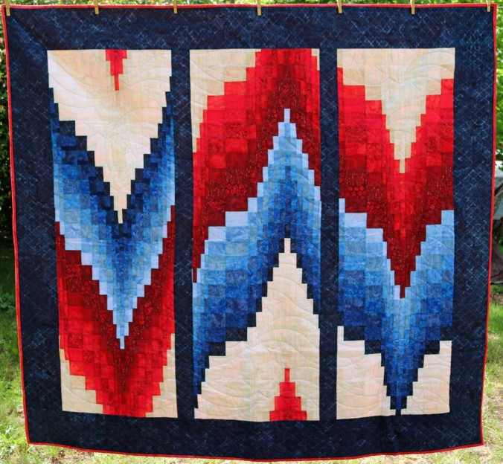
Plenary Session IV
#LWVWA2019
Raffle Drawing
★ Convention Business 

Slide 39
Plenary Session IV
#LWVWA2019
Invitation to Future Council and Convention
★ Convention Business 

Slide 40
Plenary Session IV
#LWVWA2019
Closing Remarks and Acknowledgements
★ Convention Business 

Slide 41
Plenary Session IV
#LWVWA2019
Adjourn
★ Convention Business 

