Slide 1
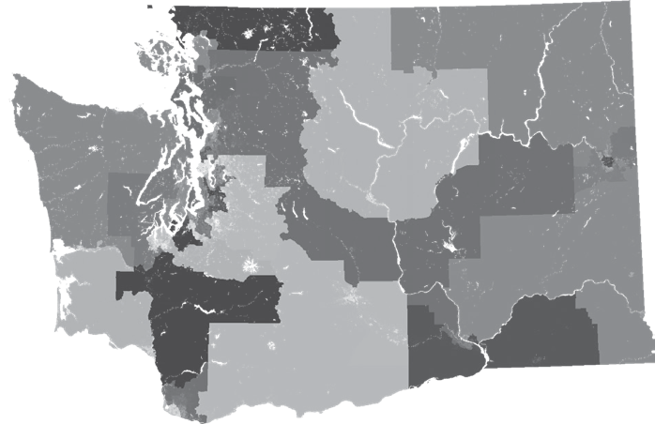


Speak-Up School
An Invitation to your Organization…
®
A project of the League of Women Voters of Washington
Notes:
Join us in our effort to create People-Powered Fair Maps in Washington State! Today’s presentation is an ask of your League. We invite you to join our national effort by agreeing to hold a Speak Up School in your County. What is a Speak Up School? We’ll give you all the details, but let’s start with some background.
The 2020 Census drives a full review of our state districting maps.
Redistricting sets representation for the next 10 years by defining your State and Federal voting districts.
Fair redistricting affects our ability to address every other issue.
Washington State has been a leader in redistricting reform for 90 years. Our process is commission–based and encourages public input.
Our commission is good. It needs updating.
It can be more effective and transparent. Incorporate more public input!
Long term goal: Add citizen commissioners who represent diverse communities
We are partnering with the LWVUS 50-state grassroots effort for People Powered Fair Maps

Slide 2


A national effort
“…state and local Leagues of Women Voters will engage residents in creating awareness about redistricting, its importance, and the impact redistricting has on how their vote is counted. Leagues will do this in their immediate and adjacent communities and in coalition with community partners.”
Notes:
From the LWV national website:
People Powered Fair MapsTM is a national redistricting program of the League of Women Voters focused on creating fair political maps nationwide. The program includes actions in all 50 states + D.C.
The work will look different in each state, but the program is comprised of five major focus areas:
Ballot Initiatives or Referendums
State Constitutional Options
State Legislative Fixes
Federal Legislative Fixes
Civic Engagement & Education
Each state will engage in at least one of the four focus areas through advocacy, education, organizing and mobilization, partnerships, litigation, and/or protection/defensive action.
The Speak Up School effort is one powerful way our state can participate in the initiative!

Slide 3



What is a
Speak Up
School?
Training sessions to prepare people to testify to the 2021 Washington State Redistricting Commission.
We are looking for 20 organizations throughout Washington to host Speak Up Schools!
Notes:
So…what is a Speak Up School? Power-packed training sessions!
Why: Speak Up Schools are a targeted strategy to improve the quality, content and diversity of input to our State Redistricting Commissioners. The 2021 Redistricting Commissioners will be hosting “Listening Sessions” in each of the 10 Congressional Districts. In the past, testimony at these hearings has not been coherent, powerful or compelling - and the Commissioners have discounted this input. The League wants to change this in 2021 – and we are willing to train folks to testify effectively. We are asking your League to agree to host a school in your district. Dates are February – April, 2021.
What and Who: These schools are targeted toward people who know why redistricting is important and may be hesitant to want to testify in front of a commission. Each session will include training on how to testify effectively, as well as suggestions for compelling talking points. We will prepare a diverse range of citizens to speak up in ways that matter! Consider these components:
Hear and learn from experienced citizen lobbyists
Learn the most effective talking points – those that will get the attention of the redistricting commission
Practice!
Create collective strategies for telling the best story
Work side by side with diverse coalition of groups & individuals who commit to testifying
We are looking for 20 local Leagues who will commit to hosting a school.
At least 5 orgs should be in Eastern Washington

Slide 4
Why host?
Benefits to Citizens
  Ensure effective input to Redistricting Commissioners: Deliver compelling talking points with confidence!
  Encourage diverse voices
  Hold Redistricting Commission accountable
  Make maps more representative of diversity
Benefits to your Organizations
  Build testifying skills – for organizations & broader community
  Strengthen ties with existing partners
  Create new partnerships
  Grow awareness of critical work of your organization
  Recruit new members or donors
®
Notes:
Why does this matter? Why should your League be involved?
There are many benefits associated with holding a school, for the citizens who participate, and for the hosting League. Hosting a Speak Up school can help build new partnerships and recruit new members. Let’s look at the list.
(Review list from slide.)

Slide 5
Local Organizations’ Responsibilities
  Host a school (between February – May, 2021)
  Identify partners
  Set venue, date and time
  Promote your School
  Provide coaches
  (Who will attend Train-the-Trainers session)
  Attend Redistricting Commission meeting in your district
  Coordinate speakers to testify!
  Collect Stories
®
Notes:
If you decide to host a school, these are the responsibilities your League will undertake:
Host a school in your county in early 2021. Schools must be completed in time to testify at May/June hearings.
Identify partners. Outreach to both existing and new partners and get commitment to partner with you on this project. Solicit sponsorships as needed. (We will discuss potential partners on the following slide.)
Set venue, date and time: You will need to find the location and work with League state coordinators to schedule the date and time.
Promote your School: Let your community know about the school. Work with your partners, local papers, radio stations and social media to get the word out. Provide a way for folks to sign up – and keep in communication about the event.
Provide League coaches for the training: 4 or 5 local League members should attend the session. These League members should be adept presenters, as they will help to coach participants. (The State League will provide Train-the-Trainers session to help prepare your identified members. These sessions will likely be internet based webinars.)
Plan to attend the Redistricting Commission meeting in your district. Coordinate speakers and plan to testify! Once hearing dates are set, make sure you have members in attendance. Follow up with Speak Up School participants to get them to the session to testify.

Slide 6
LWVWA will provide:
  Program design
    outline for the session
    Additional option modules you can add
  Trainers to train your local volunteers (in person or via Zoom)
  Talking points
    For participants
    For potential partners
    For potential funders
®
Notes:
The State League will be your partner and provide these critical pieces. We will design the training day, bring in skilled teachers, and provide detailed materials. We may be able to help secure a Keynote Speaker.
Potential sources of funding:
LWVWA Education Fund
50 State People-Powered Fair Maps grants
Local sponsors. Think about who you might ask to help underwrite expenses.

Slide 7
Potential Partners Ideas
  State and Local Coalitions
  Communities of Color serving orgs: NAACP, Latinx community, AAPI, etc
  Colleges and Universities
  Immigrant community
  Local nonprofits working with other under- represented populations (low income, disabilities)
  Tribal Governments/Councils
  Diversity Equity Inclusion (DEI) Commissions
  Environmental Organizations
  Local Chambers of Commerce, Rotary Clubs, etc.
®
Notes:
This is a beginning list of potential partners. What others can your League suggest? Who are your current partners? Who have you hoped to partner with? This project is an opportunity to forge new relationships in your community, and, potentially, to recruit new members.

Slide 8
What the day will include:
Opening Keynote on the importance of redistricting
Discussions with experience citizen advocates / communications person
Summary of lessons learn from last redistricting cycle
Collective strategies for the best story telling
Time to develop your own talking points
Individual testimony practice with feedback
Local logistics around when the commission will come to your area
Notes:
Opening Keynote on the importance of redistricting
Discussions with experience citizen advocates / communications person
Summary of lessons learn from last redistricting cycle
Collective strategies for the best story telling
Time to develop your own talking points (with worksheet/script)
Individual testimony practice with feedback (pairs first, then coach)
Local logistics around when the commission will come to your area

Slide 9
Timeline
Attend training
Speak-Up
Schools
in session
Feb-April
2021!
Leagues
commit
Invite Partners
& Promote
Testify!
Measure success
2020 2021 2022
Public Meetings
2020 Legislative Session
Census
April 2020
Commission Appointed
1/15/21
Final
maps
Nov 15
Primaries
March 2022
May/June
Sept/Oct
Notes:
This slide explains the timeline for both the WA State redistricting process and Speak Up involvement. We are working well ahead of the hearing dates, which are in May/June and September/October, 2021. This year – 2020 – will be a planning year. This is the year to outreach to potential partners and plan your schools. Speak-Up Schools will be held in early 2021.

Slide 10
Discussion
Will you commit to holding a school?
Additional questions?
Notes:
What question do you have about the process and/or timeline?
Will you host a school?
Will you send 2-4 members to a Train the Trainer Session?

Slide 11
Contact
LWVWA Lead:
To schedule your school or ask additional questions:
Alison McCaffree
LWVWA Census & Redistricting Issue Chair
253-720-6813
amccaffree@lwvwa.org
speakupschool@lwvwa.org
Notes:
Our lead in this effort is Alison McCaffree. You can contact her with additional questions, or to commit to holding a school.
However, our preferred general address for questions about this project is speakupschool@lwvwa.org.

Slide 12
Reference Slides follow…
Use as needed for additional detail or to answer follow-up questions.

Slide 13
Census = Representation!
Allocates representation
Allocates $675 Billion in federal programs (2015)
Guides research and critical questions
U. S House of Representatives
State Legislative Districts
Local Governments, Schools and Fire Districts
  Estimates say 2020 will be $900 Billion nationally
  Washington State receives $14B federal funds annual
  Businesses
  Nonprofits
  Universities
Notes:
Allocate representation
U. S House of Representatives
State Legislative Districts
Local Governments with Districts
Allocate $675 Billion in federal programs (2015)
Medical Assistance ($311B)
Supplemental Nutrition “SNAP” ($71B)
Medicare Part B ($70B)
Highway Planning and Construction ($38B)
Federal Pell Grant Program ($30B)
Research and Decide Critical Questions
Businesses – Ex: Where does Walmart put its next store?
Nonprofits – Ex: Where to have services
Universities – Population Shifts

Slide 14
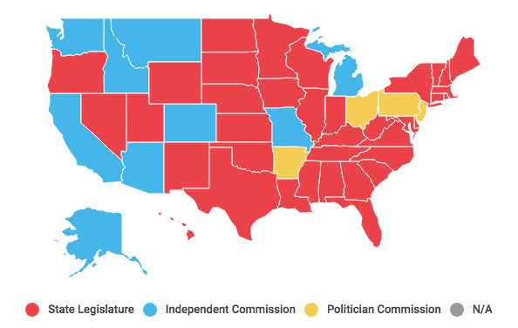
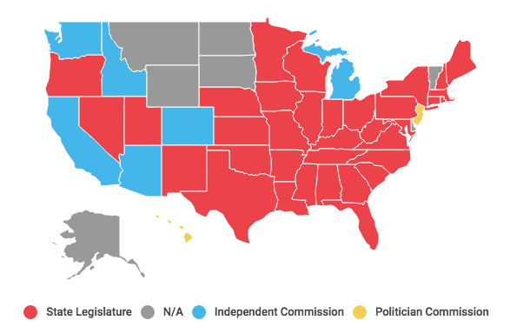
Who Chooses Districts?
Legislative Districts
Congressional Districts
** includes results of 2018 Midterms
Legislature Independent Commission Political Commission N/A
Notes:
Constitution Article I, Section 4 “The times, places and manner of holding elections for Senators and Representatives shall be prescribed in each state by the Legislature thereof, but the congress may at any time by Law make or alter such Regulations, except as to the Places of choosing Senators”
LWV pushing for Commission in WA since 1930, finally in 1983.
Arizona State legislature vs Arizona State Commission
Commission created by initiative
Republicans in Leg sued - saying it was unconstitutional
2017 Federal courts decided commission was constitutional and the maps stand
California also created by Initiative – 2008 to do Legislature and Tax Board, then in 2010 added Congressional.
Others with commission: Washington, Idaho, Montana, Alaska, (independent) Hawaii (political)

Slide 15





2011 WA Redistricting Commission
  No elected officials or party officers in prior two-year period
  No registered lobbyists within the past year
Established by constitutional amendment in 1983.
Members of the 2011 Redistricting Commission
Democrat
Republican
Senate
Non-voting Chair
House
Notes:
Five-member independent commission, requires 3 of 4 voting members to pass.
Established by constitutional amendment in 1983.
The majority and minority leaders of the Washington State Senate and Washington House each appoint one registered
No elected officials or party officers in prior two-year period
No registered lobbyists within the past year
Commission's chair:
Non-voting member, non-partisan
Appointed by four other commissioners
In the event that the four voting commissioners cannot agree on a chair, the Washington Supreme Court must appoint one.
Legislature has 30 days to amend the commission's maps by a two-thirds vote in each chamber, can only affect less then 2% of district
Chair: Laura Powell – chemist, corporate and federal gov experience, from Tri Cities.
Sen Rep: Slade Gorton – lawyer,, state house representative AG,congress senator
Sen – Dems: Tim Ceis – lawyer, chief of staff position at city and county,
House Rep: Tom Huff – Sears exec – Retail, former House Representative
House Dems: Dean Foster, - chief clerk, gov Gardners chief of staff, served on 2001 commission
Douglas Johnson, a redistricting expert and founder of the National Demographics Corporation, says “they’re pretty clearly better than the legislatures have been at taking the politics out.” Though legislatures are loath to cede power, several states have discussed the idea, with Nebraska and Illinois the most likely to switch to a commission, Johnson says.

Slide 16
Washington State
Redistricting Rules
Maintain Equal Population
Compact, contiguous, convenient
Minimize splitting Political Boundaries
  County and municipality
Preserve Communities of Interest
Prohibit Undue Favoritism
  Party or group
  Provide fair and effective representation
  Encourage electoral competition
Notes:
The state constitution requires that congressional and state legislative districts "should be contiguous, compact, and convenient, and follow natural, geographic, artificial, or political subdivision boundaries." The constitution states that the redistricting commission "must not purposely draw plans to favor or discriminate against any political party or group."[14]
State statutes require that congressional and state legislative districts "preserve areas recognized as communities of interest." State statutes also require the commission to draw districts that "provide fair and effective representation" and "encourage electoral competition."[14]
Also in statute – but not discussed here – not relevant at this time: Nesting is required…
Upper chamber district contains two or more intact districts for the lower legislative chamber.

Slide 17
Commission Timeline
April 2020 – Census
2021
Jan 15 – Commissioner Appointments
June – First round of public meetings (pre-maps)
September - Possible second round of public meetings (post-maps)
November 15 – Maps must be finalized
2022
April Primaries - New districts in use

Slide 18
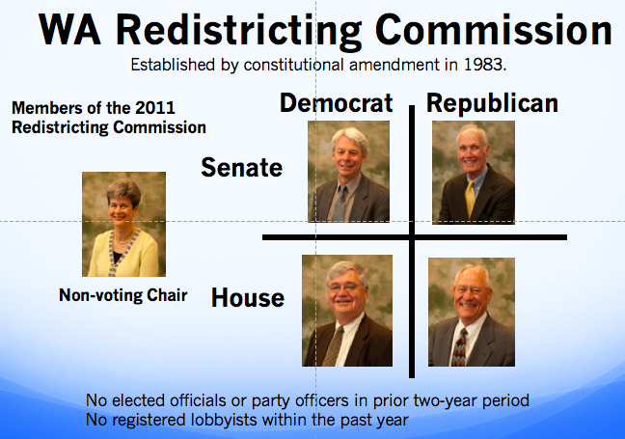
REFORM BILLS
Bill #1 - HB 2575
(2020 Session – Did not pass)
Increase Effectiveness, Transparency
and Accountability
Bill #2 – Future Work!
Create a
Citizen Commission
Notes:
Washington is one of only 9 states with independent Redistricting Commission. However – the process has created many non-competitive districts, seems to favor incumbents and has resulted in close majority control. The process can be improved!
Can distribute LWVWA 2020 Issue Paper on Redistricting and summary of Reform Bill (RCW 44.05)

Slide 19





2031 Commission
  No elected officials or party officers in prior two-year period
  No registered lobbyists within the past year
Proposed Structure
Senate
House
Citizen
Unaffiliated - Citizens
Democrat
Republican
Non-voting Chair
Require Bi-Partisan Simple Majority
Notes:
Goal: Change commission structure in 2031, via constitutional amendment to add diversity among members.
Proposal would add additional members who are not party insiders and add those who are unaffiliated with either major party.

